Slide 1
ERAS Linguistics Statistical Analyses
2/2/22

Slide 2
Task 1: Check whether the t tests were done correctly.
Yes, but can be improved in two ways.
Correct for multiple testing
Bonferroni vs Benjamini-Hochberg
Take correlation among predictor variables into account
Regression with FDR

Slide 3
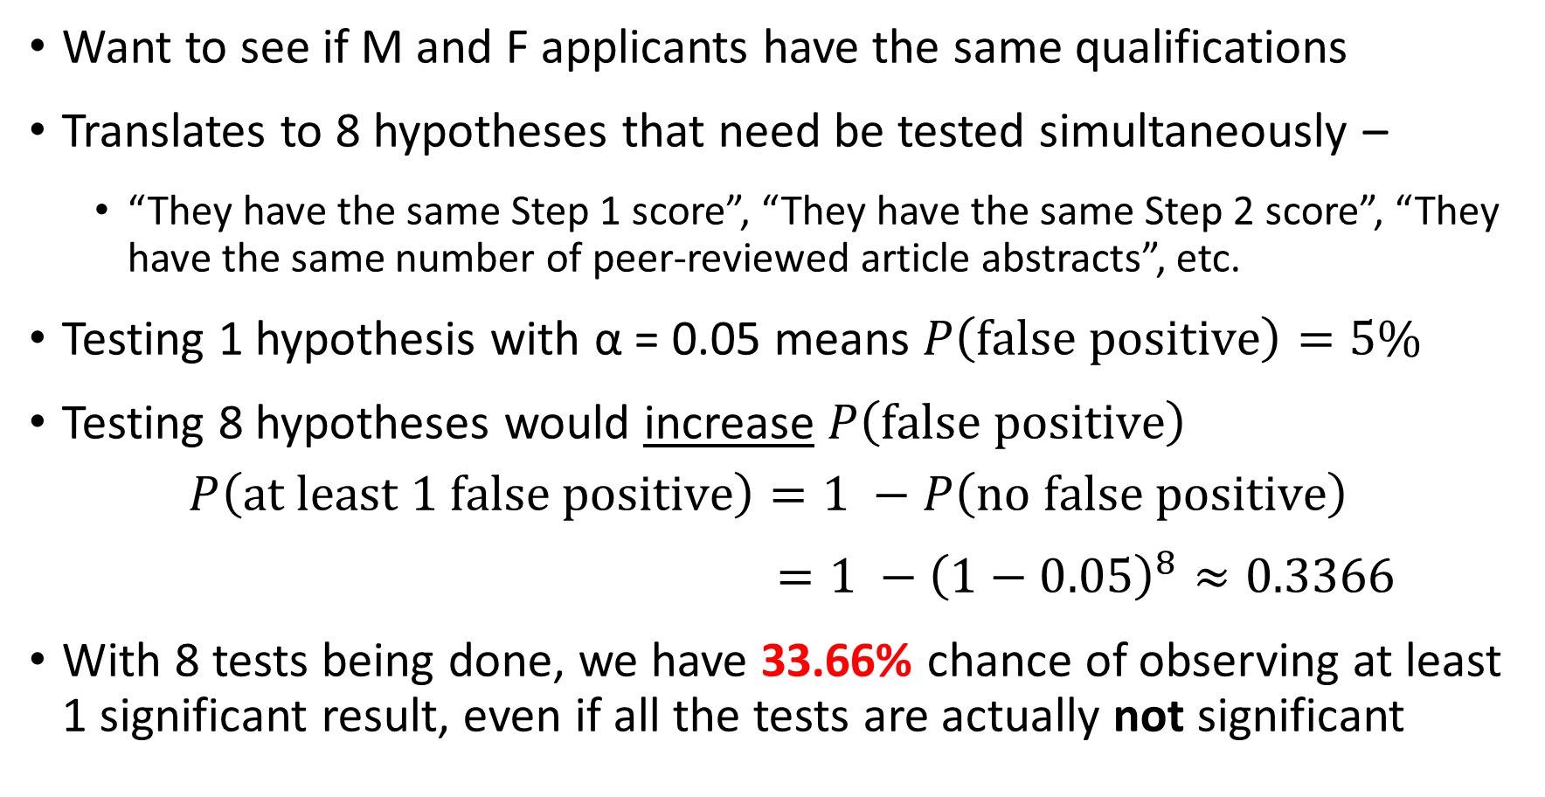
Why correct for multiple testing?
Want to see if M and F applicants have the same qualifications
Translates to 8 hypotheses that need be tested simultaneously –
“They have the same Step 1 score”, “They have the same Step 2 score”, “They have the same number of peer-reviewed article abstracts”, etc.
Testing 1 hypothesis with α = 0.05 means $P\left(false positive\right)=5\%$
Testing 8 hypotheses would increase $P\left(false positive\right)$
$$P\left(at least 1 false positive\right)=1 −P\left(no false positive\right)$$
$=1 −{\left(1−0.05\right)}^{8}≈0.3366$
With 8 tests being done, we have 33.66% chance of observing at least 1 significant result, even if all the tests are actually not significant

Slide 4
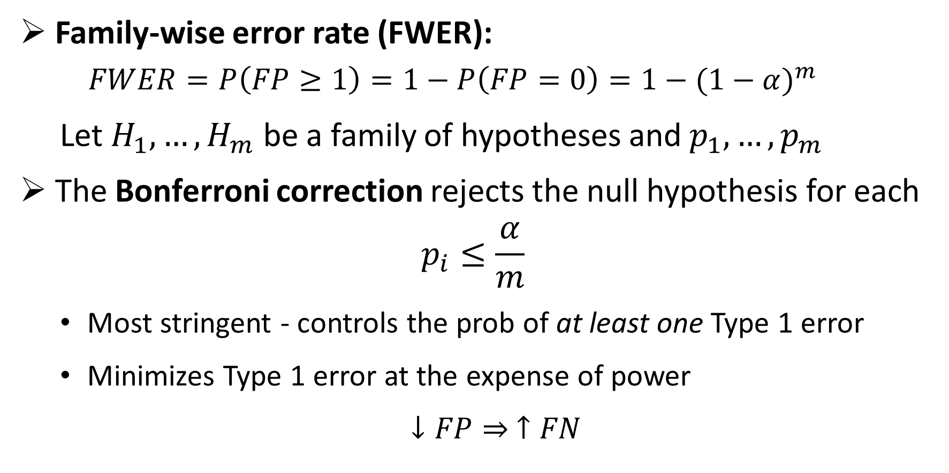

Approach 1: Bonferroni to control for FWER
Family-wise error rate (FWER):
$$FWER=P\left(FP≥1\right)=1−P\left(FP=0\right)=1−{(1−α)}^{m}$$
Let $H_{1}, …,H_{m}$ be a family of hypotheses and $p_{1}, …,p_{m}$
The Bonferroni correction rejects the null hypothesis for each
$$p_{i}≤\frac{α}{m}$$
Most stringent - controls the prob of at least one Type 1 error
Minimizes Type 1 error at the expense of power
$↓FP⇒ ↑FN$
$$\frac{0.05}{8}=0.00625$$
Notes:
The FWER is the probability of making at least one type I error in the family
by assuring FWER <= alpha, the probability of making one or more type I errors in the family is controlled at level alpha
The Bonferroni correction rejects the null hypothesis for each {\displaystyle p_{i}\leq {\frac {\alpha }{m}}}, thereby controlling the FWER at {\displaystyle \leq \alpha }.
FN = Type 2 error; power = 1 – FN = TP
FP = Type 1 error; 1 – FP = TN
0.05 / 8 = 0.00625 = 0.625%

Slide 5
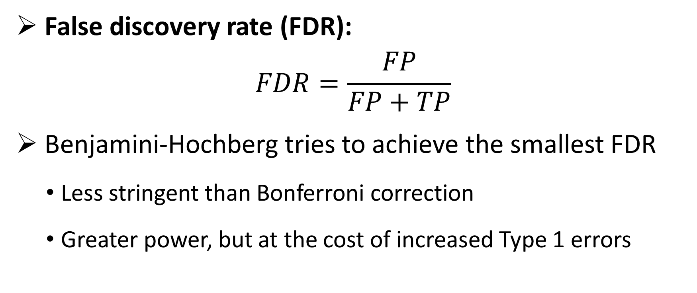
Approach 2: Benjamini-Hochberg to control for FDR
False discovery rate (FDR):
$$FDR=\frac{FP}{FP+TP}$$
Benjamini-Hochberg tries to achieve the smallest FDR
Less stringent than Bonferroni correction
Greater power, but at the cost of increased Type 1 errors
Notes:
The idea of the FDR is to try to achieve the smallest possible fraction of false signals among all those that appear to be true.
Power is the probability of avoiding a Type II error.

Slide 6
Objective Variables (10) |  | Subjective Variables (9)
Objective measures from an individual’s application |  | Qualities characterized from PS and LOR using the linguistic algorithm
Step 1 score Step 2 score Peer Reviewed Journal Articles/Abstracts Peer Reviewed Journal Articles/Abstracts Book Chapter (Peer Reviewed) Poster Presentation Oral Presentation Online Publication (Peer Reviewed) Non Peer Reviewed Online Publication Other Articles | “step_1” “step_2” “peer_art_abs” “extra_art_abs” “book_chap” “poster” “oral” “online_pub_peer” “online_pub_non_peer” “other_art” | Standout Ability Grindstone Teaching Research Analytic Clout Authentic Tone

Slide 7
2020-21 LOR Dataset

Slide 8
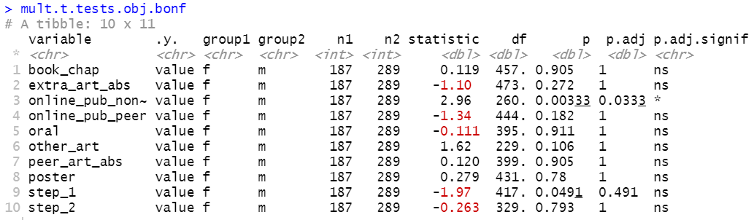
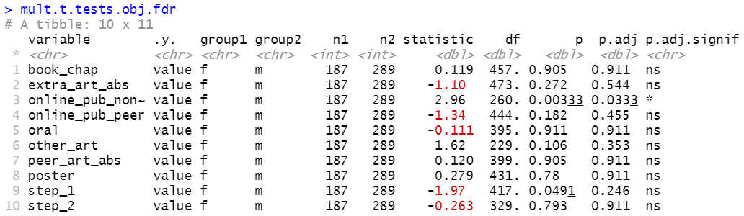
2020-21 LOR Dataset
Testing 10 Objective Variables
Group 1 female (n1 = 187)
Group 2 male (n2 = 289)
Non-peer-reviewed online publication remains significantly different between male and female applicants even after multiple testing correction.
Step 1 score is no longer significant once we adjust for multiple testing.
The two methods arrive at the same conclusion:
Male and female applicants differ only in the number of non-peer reviewed online publication (F > M).
Notes:
TO DO: why FDR over Bonferroni
Data visualization: https://www.datanovia.com/en/blog/how-to-perform-t-test-for-multiple-groups-in-r/

Slide 9
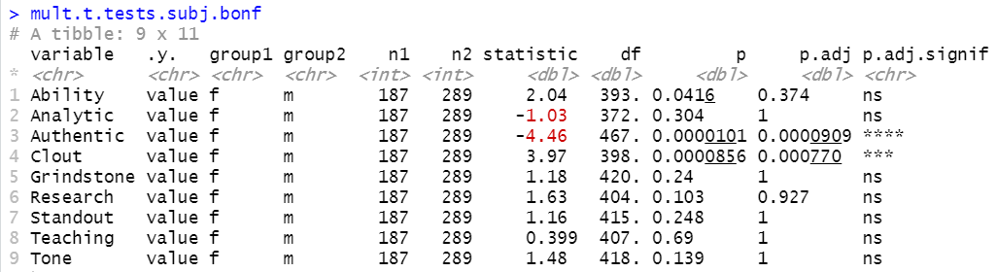
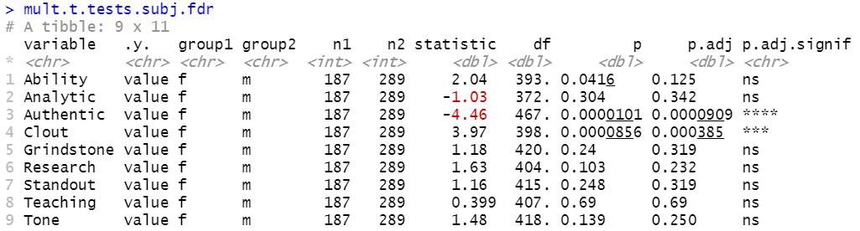
2020-21 LOR Dataset
Testing 9 Subjective Variables in LOR
The two methods give the same conclusion:
Male and female applicants’ LOR present different level of “authenticity” (F < M) and “clout” (F > M).
For publication purposes, I recommend reporting results from FDR control.
Notes:
Bonferroni minimizes the probability of making at least one false rejection of a null hypothesis.
Benjamini-Hochberg controls the proportion of wrongly rejected null hypotheses amongst those that are rejected (instead of amongst all).
False discovery rate (FDR) is the expected proportion of tests which are incorrectly called significant out of all the tests which are called significant.
The Benjamini-Hochberg (BH) method is a procedure which controls the false discovery rate so that FDR ≤ α.
The difference between the two types of approaches is about the goal and desired error control. E.g. in settings when there is a huge number of signals that need to be screened based on not very much data to determine whether something should be explored further, FDR control may be the most sensible. However, the results should then not be interpreted, as if a strict familywise type I error control had been applied. In contrast, for deciding what claims a drug company can do about a drug based on a clinical registration trial, strict familywise type I error rate is more usual.

Slide 10
Take correlation among predictor variables into account
We can reasonably assume that there might be correlations among the predictor variables
Important to take correlation into account – regression model
Q’s answered by the model
Does any X differ significantly between male and female? If so, which one(s)?
Brief summary of the operations done:
Perform repeated regressions
Calculate the FDR with Benjamini & Hochberg correction
Find which variables should be retained for or excluded from further multivariate analysis according to their corrected p values
Notes:
Why is it important to take correlation into account?
(TO DO)

Slide 11
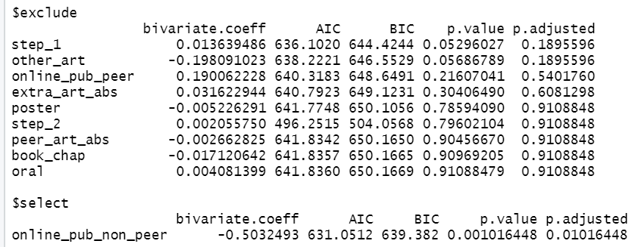
2020-21 LOR Dataset
10 objective variables: bivariate p values adjusted with FDR correction
1 variable was selected and 9 variables were excluded from the model
NEED TO RE-RUN THE DATA!!!!
M and F applicants differ only in non-peer-reviewed online publication. This is the same conclusion as those arrived by the previous multiple testing approaches. The agreement increases our confidence in the conclusion.

Slide 12
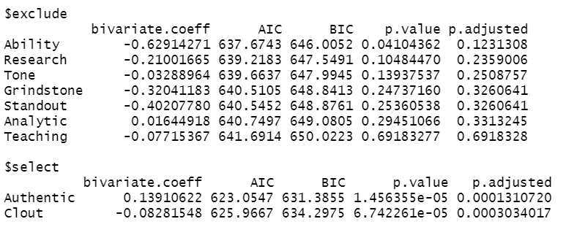
2020-21 LOR Dataset
9 subjective variables from LOR: bivariate p values adjusted with FDR correction
2 variable was selected and 7 variables were excluded from the model
The regression model shows male and female LORs differ in Authentic and Clout. This is the same conclusion as those arrived by the previous multiple testing approaches. The agreement increases our confidence in the conclusion.

Slide 13
2019-2020 LOR Dataset

Slide 14
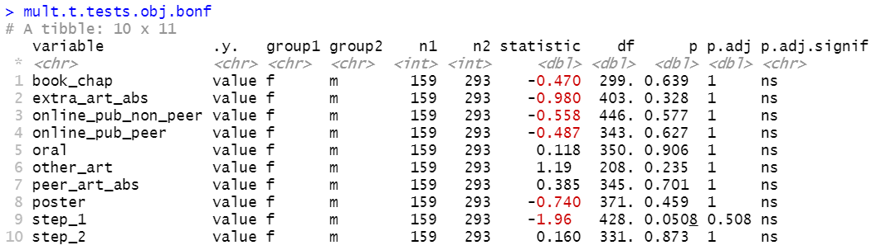
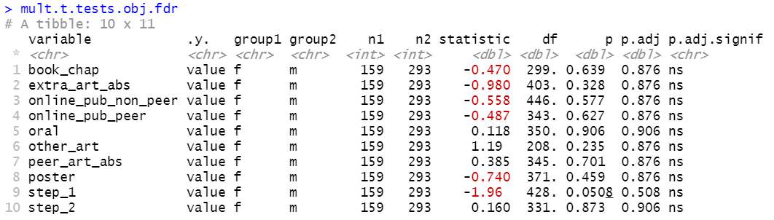
2019-20 LOR Dataset
Testing 10 Objective Variables
Group 1 female (n1 = 159)
Group 2 male (n2 = 293)
The two methods arrive at the same conclusion:
No significant difference between M and F across any of the variables.

Slide 15
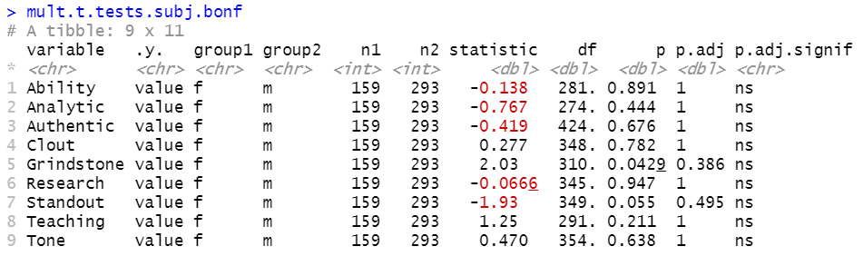
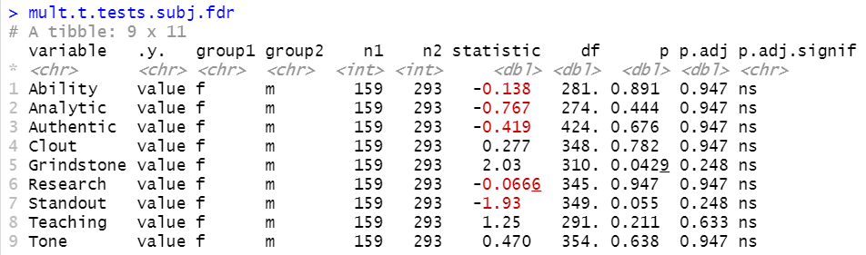

Slide 16
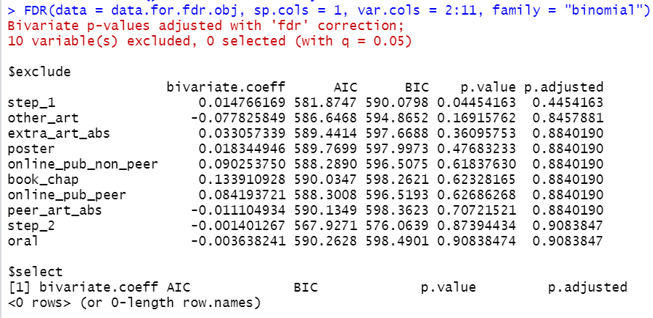
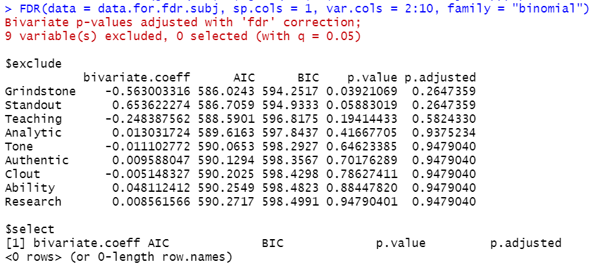

Slide 17
Task 2: substitute metric for Step 1 score?
Linear regression with possible transformation

